Slide 1
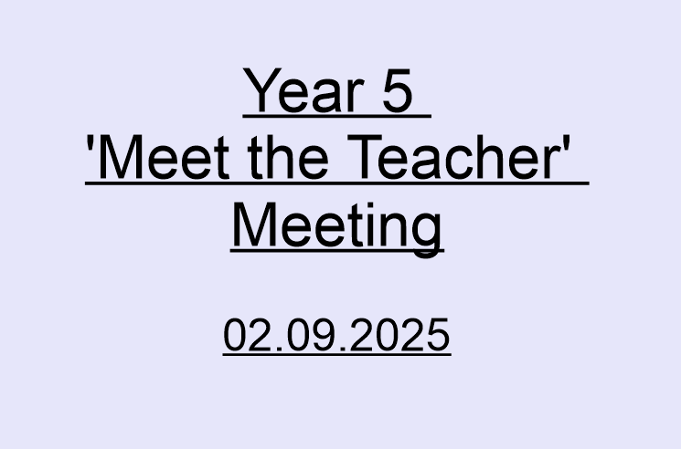

Slide 2
Housekeeping

Slide 3
5.1
Mrs Baldwin
5.2
Miss Holland
5.3
Mrs Patankar
Associate Staff Members:
Mrs Parvez
Miss Anjum
Miss Broughton
Mrs Carney
Miss Copley
Teachers

Slide 4
Attendance
Important to attend school everyday.
Arrive on time at 8:45 am.
Inform school if your child is sick.
Phone call or on the app.

Slide 5
Reading
Please help your child to read their book every night and sign off their reading and homework journal.
Ask them questions about the story to help improve their reading skills.
We will endeavour to change reading books at least once a week in class.
Children will visit the library every week. These books need to be returned each week.

Slide 6
Homework/ Useful Websites
Given out: Friday
Collected in: Wednesday
Maths (TTRS), Spellings (Spelling Shed) and reading.
Could you please make sure that your child completes their homework by the correct day.
Parents and older siblings are encouraged to work with children on homework.
We encourage all children to look at their homework on a Friday evening.
Spellings will be given out on a Friday and tested in class the following Friday Children also need to use these words to write sentences with at home. Teachers will go through the spelling words and relevant activities on a weekly basis to support this too.

Slide 7
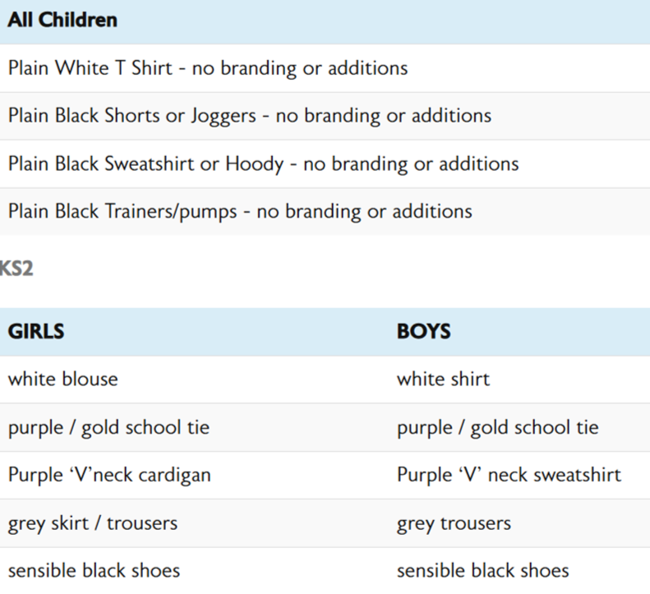
School Uniform In winter, please provide a coat, hat, gloves etc.
PE Kit

Slide 8
PE
Year 5 have PE on Fridays.
We have PE on a rotational basis on a Wednesday. The dates are on the website.
Children will need to come in their school P.E kits on P.E days.
This consists of:
A plain white polo shirt/T shirt with no logos.
Plain black jogging bottoms/ shorts.
Black pumps or trainers.

Slide 9
Swimming
Swimming kit consists of:
* Swimming costume/ cap
* Hair ties/ Brush
* Towel
- If your child is not participating, please speak to a teacher or send a note in to school.
- Pre-visits possible.
Year 5 have Swimming on Thursdays.
Half the cohort - September - Feb
Half of the cohort - Feb - July
An app message should've been sent to you as to when your child will be swimming yesterday.

Slide 10
Collection Arrangements
Year 5 children are allowed to walk to and back from school on their own.
If they are 'walkers' we allow them to bring a phone to school. Children are NOT allowed to bring in their mobile phone to school if they are not a 'walker'.
A form needs to be filled in at the office even if this is walking to the top playground.
Children are expected to switch the phones off on school grounds. Children hand their phones into the adults in the cloakrooms and it will be placed in a safe and secure box in the office for the day.

Slide 11
Reminders
The doors will be open from 8.45am.
Please note: The doors and gates will be closed at 8.55am, after which time you must take your child to the school office where they will be marked as late arrivals.
The school day finishes at 3.30pm. Please collect your child from the class’ designated collection area in the KS2 playground. If you have not collected your child by 3.40pm they will be taken to the school office for collection.
REMEMBER: Let a member of staff know if someone other than yourself is collecting your child. For safety reasons we will not allow a child to go home with someone unless their main carer has informed the office or notified a member of staff.

Slide 12
Fieldwork Visits and Workshops
We have tried to keep costs at a minimum.
Art Workshop - Free
Ovenden Wind Farm - Free
A healthy lifestyle workshop - Free
Space planetarium - £4.70
Jorvik Viking Centre - £12
Grinton Lodge residential - optional - separate meeting for Grinton residential
School Garden - Free
VR Workshop - Free
Beatboxing Workshop - Free
Plummer Drummer Workshop - Free

Slide 13
Topics in Year 5
Key Drivers for each half term:
Autumn 1 - Renewable and Non Renewable Sources
Autumn 2 - Space/ Science
Spring 1 - Vikings
Spring 2 - Land Use and Settlements
Summer 1 and 2 - Ancient Greece

Slide 14
Any Questions?

