Slide 1

Dobroyd Castle Parent Information Meeting
Tuesday 9th June 2026

Slide 2
Parent Meeting- Outline:
- Kit list and things to bring
- Activities the children will be doing
- Sleeping arrangements
- Meals
- Medicines (medical forms)
- Illness
- Keeping up to date
- Timetable
- Questions

Slide 3
Kit list - things to bring. This will be uploaded onto the school website for your reference.
Ensure all bags and clothing are labelled clearly with your child’s name. (This helps your child identify their items when hanging up in the drying room, for example!)
There is no need to go out and buy anything special for a trip to Robinwood, all specialist equipment is provided. The clothing list given includes clothing being worn on the journey (so if you are wearing a pair of trousers for the journey, you only need to pack 2 more pairs).
3 T-shirts (no vests or crop tops)
5 Sets of underwear
6 Pairs of socks
2 Pairs of trainers
2 Towels
1 Waterproof coat
3 Comfortable long-sleeved tops (sweatshirts/jumpers/hoodies/fleeces)
3 Pairs of trousers (not restrictive; sportswear is good/ideally not jeans)
2 Pairs of shorts (knee length) or leggings you don’t mind getting wet
1 Sun hat (in warm weather)
A spare Head Scarf (if you wear one)
1 Set of nightwear
1 Bin liner (for wet clothes on day 3)

Slide 4
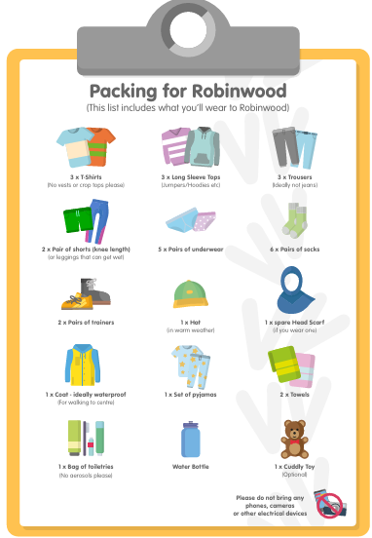

Slide 5
Kit list - things to bring
Items not to be brought
Mobile phones or smart watches
Cameras (including disposable)
Electronics (e.g. computer games, ipads/tablets)
Jewellery (including no earrings or watches)
Toys
Aerosol sprays (due to the sensitivity of the smoke alarms)
Sweets/ snacks
Money
Medicines
If your child requires any medicines administering during the trip you will have to complete relevant medical forms prior to departure. A separate form will be sent home for you to complete. Medicines must be clearly labelled with your child’s name and handed in to staff on the morning of the trip.
Due to the practical nature of the activities, please no jewellery, including no earrings.

Slide 6
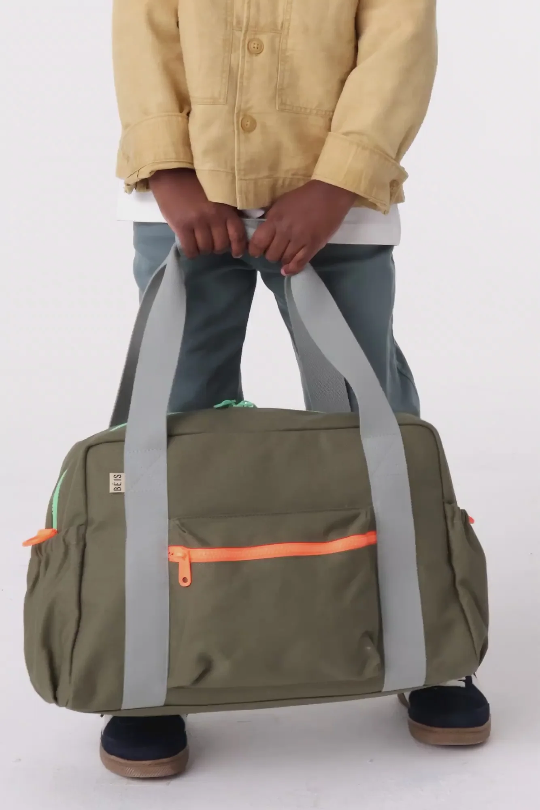
Please do not bring a very large piece of luggage. Please bring a medium sized bag. (like a weekend bag). This will avoid space issues.

Slide 7
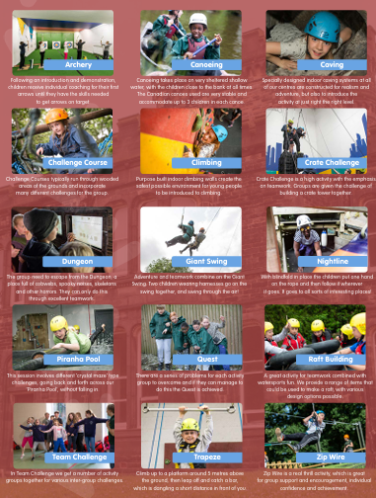
Activities:
Canoeing
Climbing
Challenge courses
Team building activities
Trapeze
Zip wire
Piranha pool
Dungeon
Giant swing
Nightline

Slide 8
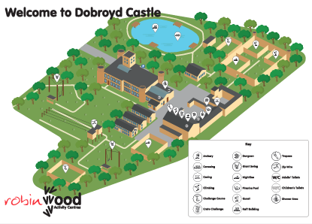

Slide 9
Sleeping arrangements
- Children will be put in dormitories in groups. Girls and boys dormitories are separate.
- Bedding is provided. Children not to bring sleeping bags.
If you are aware that your child occasionally can have an accident during the night, please make their class teacher aware. This will be discretely changed without causing embarrassment.
- Most dorms have a sink so that children are able to brush their teeth. Shower and toilet cubicles are near to rooms and self contained. All boys and girls bathrooms are separate.
- Children will have opportunity to shower and this is timetabled into the day.
- All the children have noted up to three children that they would like to share a room with in order of preference. All children will get at least 1 child from the three they have selected. Children will find out who they are sharing a dorm with when they get to Dobroyd Castle.

Slide 10
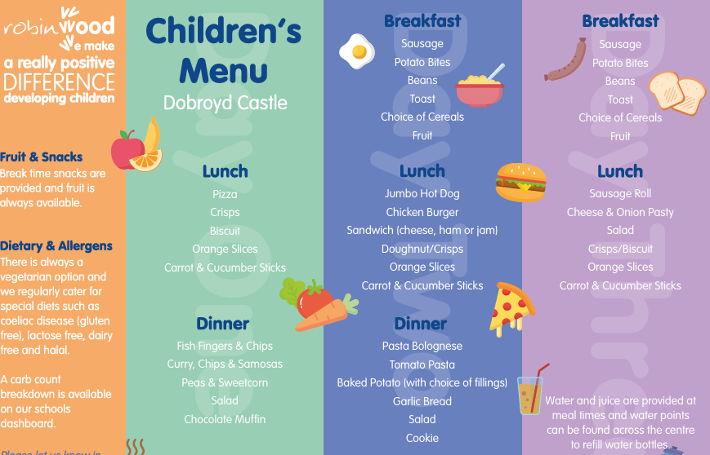
Meals
Halal options are available
Pesto Pasta & Mac and Cheese | Jacket Potato | Brownie | Choc Ice | Fruit

Slide 11
Medicine and medical forms
You had 2 medical forms to complete and we have received these responses for all the children attending.

Slide 12
Medicine and medical forms
Any medicine being brought on the trip needs to be labelled clearly with your child’s name, be in date and given to a first aider on the morning of the trip (Miss Broadbent).
All medication will be administered to children according to the parental consent forms.
These forms need to mirror school records. For e.g. If you have stated that a child needs to be administered ‘Piriteze’ this needs to be on school records and so a separate school medical form will need to be filled in at the office.

Slide 13
Illness
If your child has had sickness within the last 24 hours before departure, they will be unable to attend the residential.
If your child becomes ill whilst at Dobroyd Castle:
A designated first aider will make an assessment as to whether your child needs to return home.
If they do not need to return home, the first aider will make the decision about the ability of your child to undertake activities. First Aider will stay with the child.
Parent contacted and informed by Miss Rankin and a decision for next steps agreed.
If your child needs to go home then Miss Rankin will contact Mr Cooper and parents will be called to come and collect your child.
First Aider to stay with your child until parent collects.

Slide 14
Keeping up to date
- If there is an emergency and you need to contact your child, this needs to be done through the school. Do not contact Dobroyd Castle directly.
- If a child becomes unwell we will contact you. There are First Aiders from Wibsey with us and First Aid staff at the centre.
Daily Communication
- Daily updates as to how the children are doing will be sent out via the School App.
- We will also update you as to when we have arrived at Dobroyd on Monday and when we have departed on Wednesday.
- Photographs on the website of children at the end of the day. Not a ‘normal’ school day. Only for children that have consent.
- If you are not on the school app please can your child’s class teacher be notified.

Slide 15
Please note
If children do not follow the rules and it is decided that they need collecting, then it is the parent’s responsibility to ensure that they have suitable transport arrangements in place for if that were to be the case. This also applies to any child that brings in any items from the items NOT to be brought in the list.
Any money paid for the residential will not be refunded and children will not be able to take part in the rest of the residential activities.

Slide 16
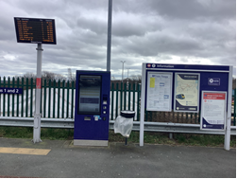
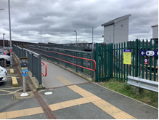
Monday 13th July
Departure
-
9:30am Parents to drop their child off at Low Moor station. Children do not go to school before this time.
Hand any medication to Miss Broadbent and Miss Tordoff.
Parents to stay at this side of the bridge and children to walk across with staff
The train departs at 10:10am so please do not be late.
If your child misses the train that it will be your responsibility to take them to Dobroyd Castle.
Consider car pooling with other parents due to parking around the station.

Slide 17
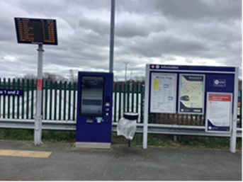
Arrival Back at Low Moor station- Wednesday 16th July 2026
Train is due to arrive at Low Moor station at 2:11pm
Parents to wait at pick up point
Staff to take children across the bridge to the collection point.
Children to be dismissed.
Children do not need to return to school.
We will inform you via the APP if the train is delayed.

Slide 18
SEND
All children will have a RA in place.
SEND children will have a specific, individualised RA. This will be shared with parents and the school SENCO.
All staff members will be aware of all RA’s. Staff meeting prior to the residential will be briefed on 30th June
All RA’s have to be verified and signed off by the LEA (David Maw).

Slide 19
Questions from previous residentials:
- Emergency Contact: The emergency contact number for parents is 07544023694. We kindly ask that for any non-emergency communication, please contact the school office as the first point of contact. If it is outside of school hours and there is a SEVERE emergency situation, please contact the number above. This is not for general use.

Slide 20
Any Questions?

