Slide 1


Preparing children for the transition to school and school readiness

Slide 2

Pathway to School
Starting school is an exciting step for your child and your family.
It is normal for children and parents/carers to feel
excited and anxious about starting school as it is the first big change for them away from you.
Staying relaxed and calm will support your child to feel less anxious about school and you can help a lot by talking together with your child to help them understand what to expect when starting school.

Slide 3
In the months leading up to school…
Talk about the fun things that will happen at school
e.g. playing with friends, painting, story time.
Share photos from the school’s website to help your
child become familiar with the school.
Practise the school routine such as trying on uniform, travelling to school – supporting your child to dress and undress independently.
Read books together about school – you could visit
your local library to find books here too.
Attend any transition days school has on so your child
is familiar with the school, staff and peers.

Slide 4
How to support children to be `school ready`
Encourage independence:
• Practise dressing and undressing independently. Learn to do zips and buttons and put shoes and socks on and off.
• Practice using the toilet independently, wiping themselves, flushing and washing hands.
• Practice eating independently using knives, forks and spoons.
• Encourage listening, paying attention and following instructions- Playing games, pretend role play, reading stories, cooking, arts and crafts all offer opportunities for children to practise these important skills.

Slide 5

Language development
Time to Talk: Engage in conversations and activities that promote speaking. Parents who just go about talking to their child about their daily activities expose their children to 1000-2000 words every hour!
Encourage children to express their needs and feelings clearly, such as when they are hungry, tired or need help.
Encourage asking for help: If your child needs help with something they will need to ask an adult.
Encourage your child to speak in full sentences to communicate their needs to you rather than pointing or by you guessing.
It is really helpful for your child to be able to communicate their needs, e.g. if they are wet, need the toilet, are thirsty or hurt.

Slide 6
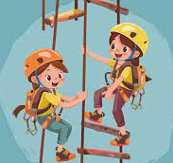
Physical Development
Encourage Gross Motor Skills: Practice running, jumping and climbing. Visit the park, attempt the monkey bars, go swimming. Anything that encourages physical strength and co ordination is great.
Encourage fine motor skills : Help your child prepare for school by drawing, colouring, cutting, and writing their own name at home. Show them how to hold a pencil correctly and encourage this. Repeated actions like these will help them adjust and feel more confident for when they have to do the same in school.

Slide 7

Language and Literacy
Encourage a love of reading: Enjoy sharing books and reading together daily. This really helps children grow and develop their vocabulary. When the majority of children start school they will not be able to read books but if they can enjoy a book, know how to hold it and know how to turn the pages this helps with some of the foundations for learning to read.
Sing Nursery Rhymes together: Did you know that if a child knows 8 nursery rhymes by heart by the time they are 4 years old they are usually among the best spellers and readers in their class by age 8.

Slide 8
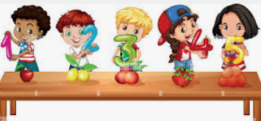
Early mathematics
Encourage basic Maths skills: Counting aloud, counting objects, spotting numbers out and about, spotting patterns, spotting and labelling shapes. Recognising colours. These are all skills that can be practised out and about or around the house.

Slide 9
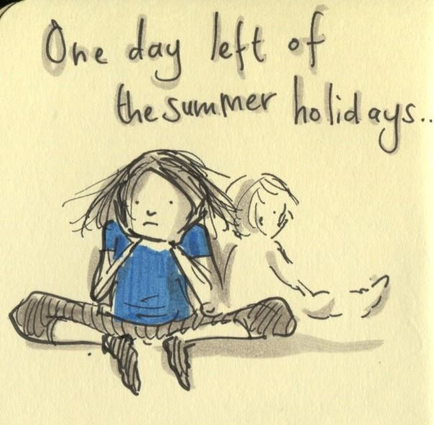

The night before school
Get everything ready – check all clothes and possessions are labelled with your child’s name. Ask your child to help you lay out their clothes ready for the next day.
Talk about going to school – remind your child about what will happen, what they will do and that however they are feeling is okay. Talk about this together and say “I know you feel a bit worried and this is OK, I get worried too”. Ruby’s worry is a brilliant story to discuss worries together.
Get an early night – Make sure your child gets lots of rest ready for the big day ahead.

Slide 10

The first day of school
Breakfast – Eat a healthy breakfast to help your child concentrate at school.
Leave plenty of time – Plan extra time so you have plenty of time to get ready as you do not want to rush and cause any upset. This way you can get to school nice and early and by more relaxed and ready to start the day.
Take a photo – A lovely way to remember the first day of school.
Say goodbye and reassure your child – Tell them who is collecting them and that it will not be long. Make sure you do not simply sneak away and have said bye as this can sometimes cause more upset. You could leave a little message in your child's bag or draw matching pictures on your hand and their hands.
Asking for help – remind your child to ask for help from a teacher of friend if they are upset, worried or unsure of something.

Slide 11
Being ‘School ready’
Support your child to:
Have a go at new things and keep trying even when they are difficult.
Make their own choices and follow routines.
Know about their feelings and naming them.
Get help from others when they need it.
Follow simple instructions.
Listen and take turns when talking.
Join in with songs, rhymes and stories.
Use a knife and fork correctly.
Use scissors and a paintbrush correctly.
Make marks using pens and paper – drawings or sometimes the letters of their name.
Use the toilet independently and wash their hands after too.
These are all important skills to give your child the best start in Reception.

Slide 12
Concerns
If you have any concerns or questions about being school ready then please:
Talk to a health professional such as your GP or Health Visitor.
Discuss your concerns with your child’s teacher, SENDCO Mrs Mitchell and Deputy SENCO Mrs Meadowcroft.
Visit our school website.

Slide 13
Thank you

