Slide 1

Welcome to Year 1
24th September 2026

Slide 2
Meet the staff
Class teachers
Miss Hammond 1.1 class teacher
Miss Huddlestone 1.2 class teacher
Mrs Kershaw 1.3 class teacher
Associate staff
Mrs Arato
Miss Lee
Ms Rawlins
Mrs Robertshaw
Mrs Paige

Slide 3
A day in Year 1
Morning
  Daily maths, English, phonics
  Snack
  Assembly
  Playtime
  Afternoon
    Lunch and playtime
    Foundation subjects (Science, History, Geography, Art, PE etc)
    Story time

Slide 4
Curriculum
English: Sentence writing, story retells, character descriptions, instructions, fact files and letters
Class Novels: What makes me a me? In every house in every street, Beegu (Autumn term), Tatty Ratty, Jasper’s beanstalk (Spring term), Meerkat Mail, Giraffe’s can’t dance (Summer term)
Maths: Autumn term: Place value within 10, addition and subtraction within 10, money and shape
Spring term: Place value within 20, addition and subtraction within 20, place value within 50, length and height and mass and volume
Summer term: Multiplication and division, fractions, position and direction, plave value within 100 and time
Science: Autumn 1 and 2: humans (parts of the body and the 5 senses). Spring 1: materials. Spring 2: plants. Summer 1 and 2: animals. Ongoing through the year- seasonal changes
Computing: using a computer, digital painting, programming (beebots), moving pictures (scratch Jr)

Slide 5
Curriculum
History: Wibsey in the past, toys in the past and brilliant Bradfordians
Geography: Our local area- Wibsey, Hot and cold places (Antarctica, Kenya)
RE: Festivals, special books and stories, being part of a community, caring for others
WSFL: Developing a healthy lifestyle, managing finances, effective decision making, engaging with the community, managing relationships, understanding rights and responsibilities
Art: Drawing, painting and Collage
DT: Design and make: a fruit salad, a bridge and a moving picture
PE: Games, gymnastics, dance and athletics

Slide 6


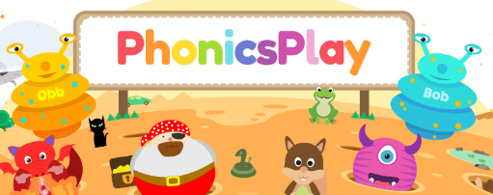

Phonics
Daily small group Read Write Inc phonics sessions
Half-termly assessments
Year 1 phonics screening in June
Useful websites: Phonics Bloom and
phonics play
RWI QR codes sent home
Reading at home helps. Try to read their book 3 times a week, to help build fluency.

Slide 7
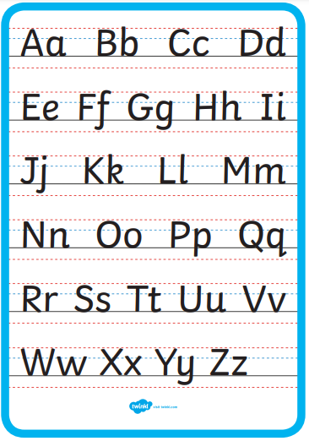


Handwriting

Slide 8
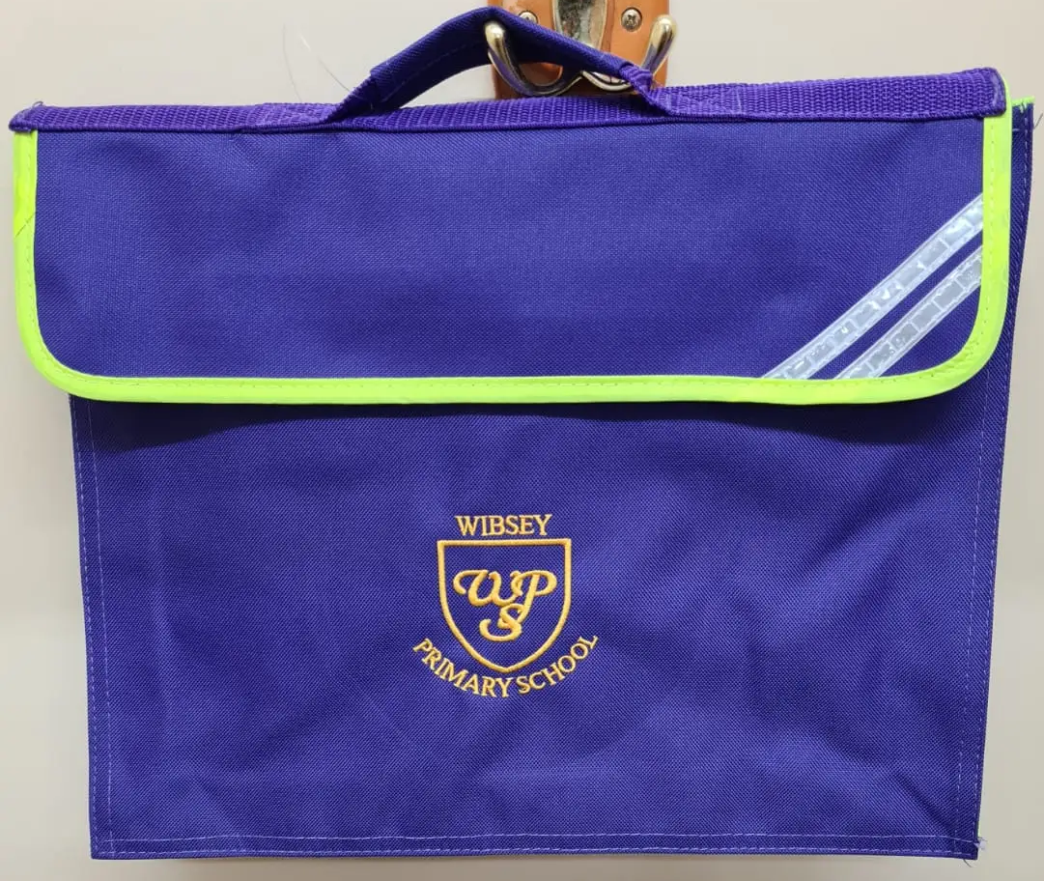
Book bags
To be brought in every day
School book bags
Book linked to phonics group
Reading for pleasure book
Spelling book, linked to phonics group
Reading journal

Slide 9
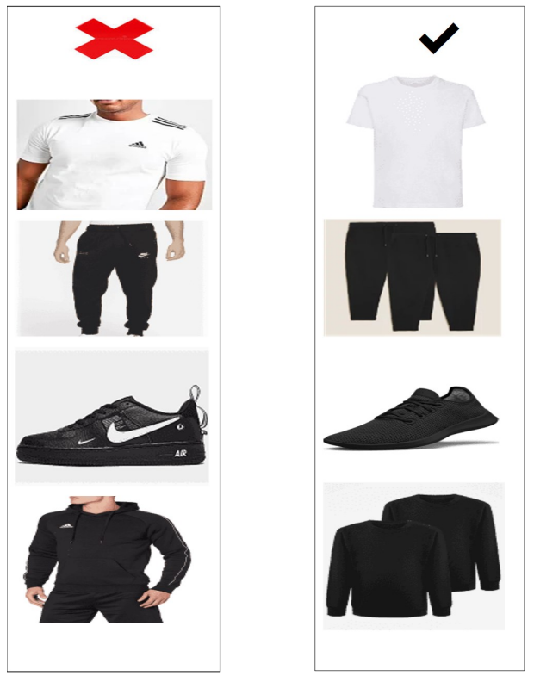
PE
1.1 and 1.3 every Tuesday
1.2 every Friday
All classes have additional days on a Monday. See the school website for your child’s dates.
Kit
  Come to school in PE kits
  Named clothing
  Plain black shorts or jogging bottoms, plain white T shirt, plain black jumper or hoody.

Slide 10
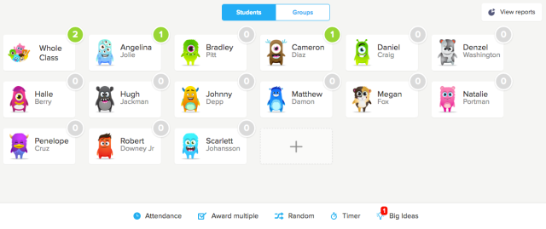
Class Dojo

Slide 11

Homework
Autumn term: weekly spellings and reading practise
Holiday homework: sent at the end of each half term- linked to topic
From Spring term onwards: Weekly homework- linked to English or maths
Maths will be set on MyMaths. Login details will be sent out and your child’s login details will be stuck into your child’s reading journal.
English will vary, this could include sentence writing, letter formation practise etc

Slide 12
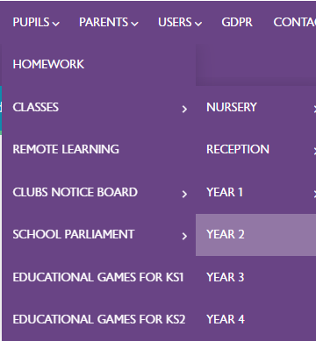
Half termly letter
Letter uploaded to school website outlining our topic for the half term, key learning question, school trips, PE dates and more.

