Slide 1

Welcome to Year 2
^{22nd September 2026}

Slide 2
Meet the staff
Mrs Askham and Miss Faulkiner - 2.1 Class teacher
Mrs Ellis-Barker - 2.2 Class teacher/ Phase Lead/ Assistant Head
Miss Ahmed - 2.3 Class teacher
Mrs Meakin
Miss Airstone
Mrs McCormack
Miss Burniston

Slide 3
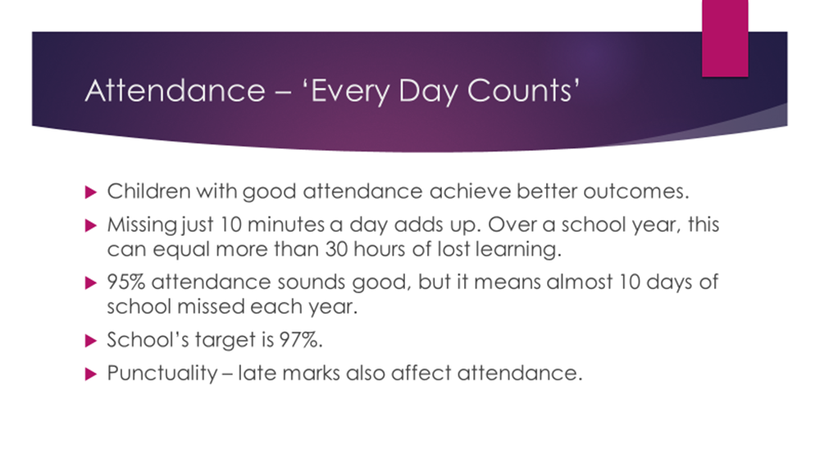

Slide 4
This academic year any class with 100% attendance will be able to have a movie afternoon to watch any film of their choice (U only).
Any class with 97% attendance or higher will be able to enjoy an extra breaktime.

Slide 5
A day in Year 2
Morning
  Morning arithmetic
  Maths
  Assembly
  Break
  Phonics/reading
  English
  Afternoon
    Lunch and playtime
    Handwriting
    Foundation subjects (History, Geography, Science, Art, PE etc)
    Story time

Slide 6
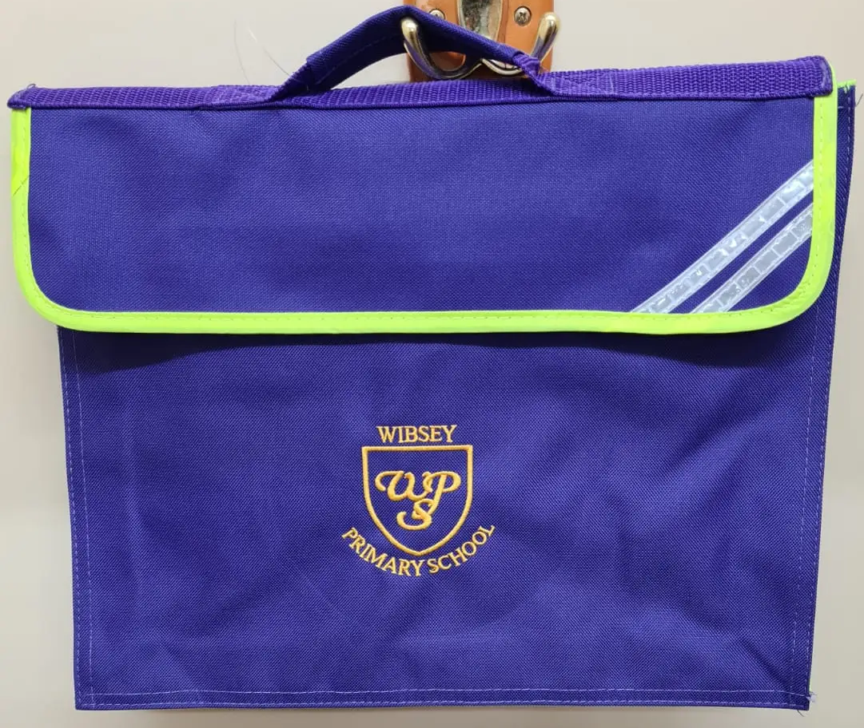
Book bags
To be brought in every day
Book linked to phonics group
ZPD book (RWI Grey or above)
Reading journal
Water bottle

Slide 7
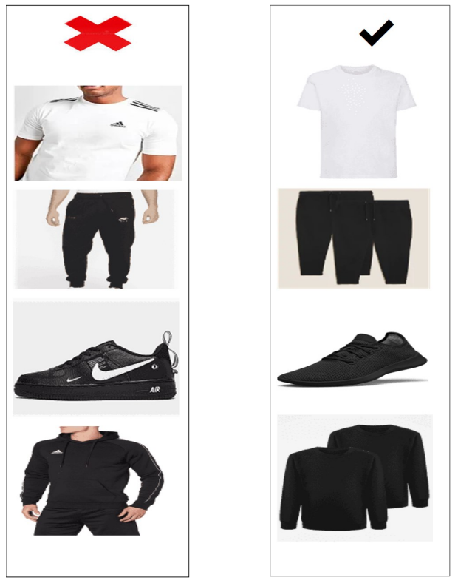
PE
2.1 Friday
2.2 Friday
2.3 Wednesday
All classes have additional days on a Thursday. See the school website for your child’s dates.
Kit
  Come to school in PE kits
  Named clothing
  Plain black shorts or jogging bottoms, plain white T shirt, plain black jumper or hoody.

Slide 8
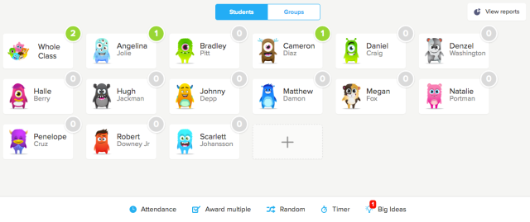
Class Dojo
Dojos are swapped for rewards

Slide 9



Homework
Log in details stuck onto your child’s reading journal
  My Maths
  Times Tables Rock Stars (TTRS)
  Weekly reading – record in reading journal
  Spellings – orange book or Spelling Shed

Slide 10
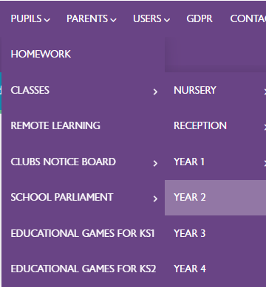
Half termly letter
Letter uploaded to school website outlining our topic for the half term, key learning question, school trips, PE dates and more.

Slide 11
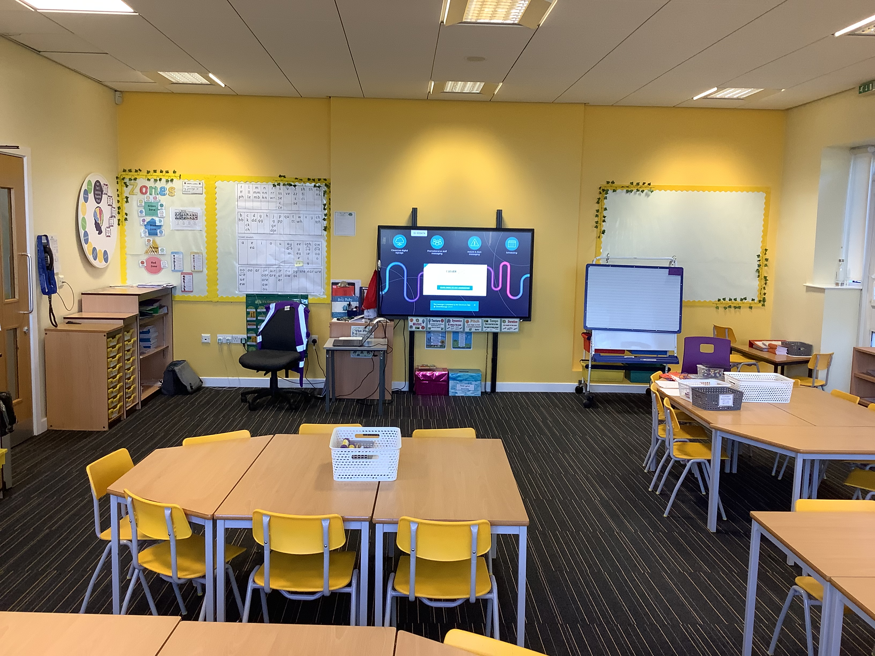
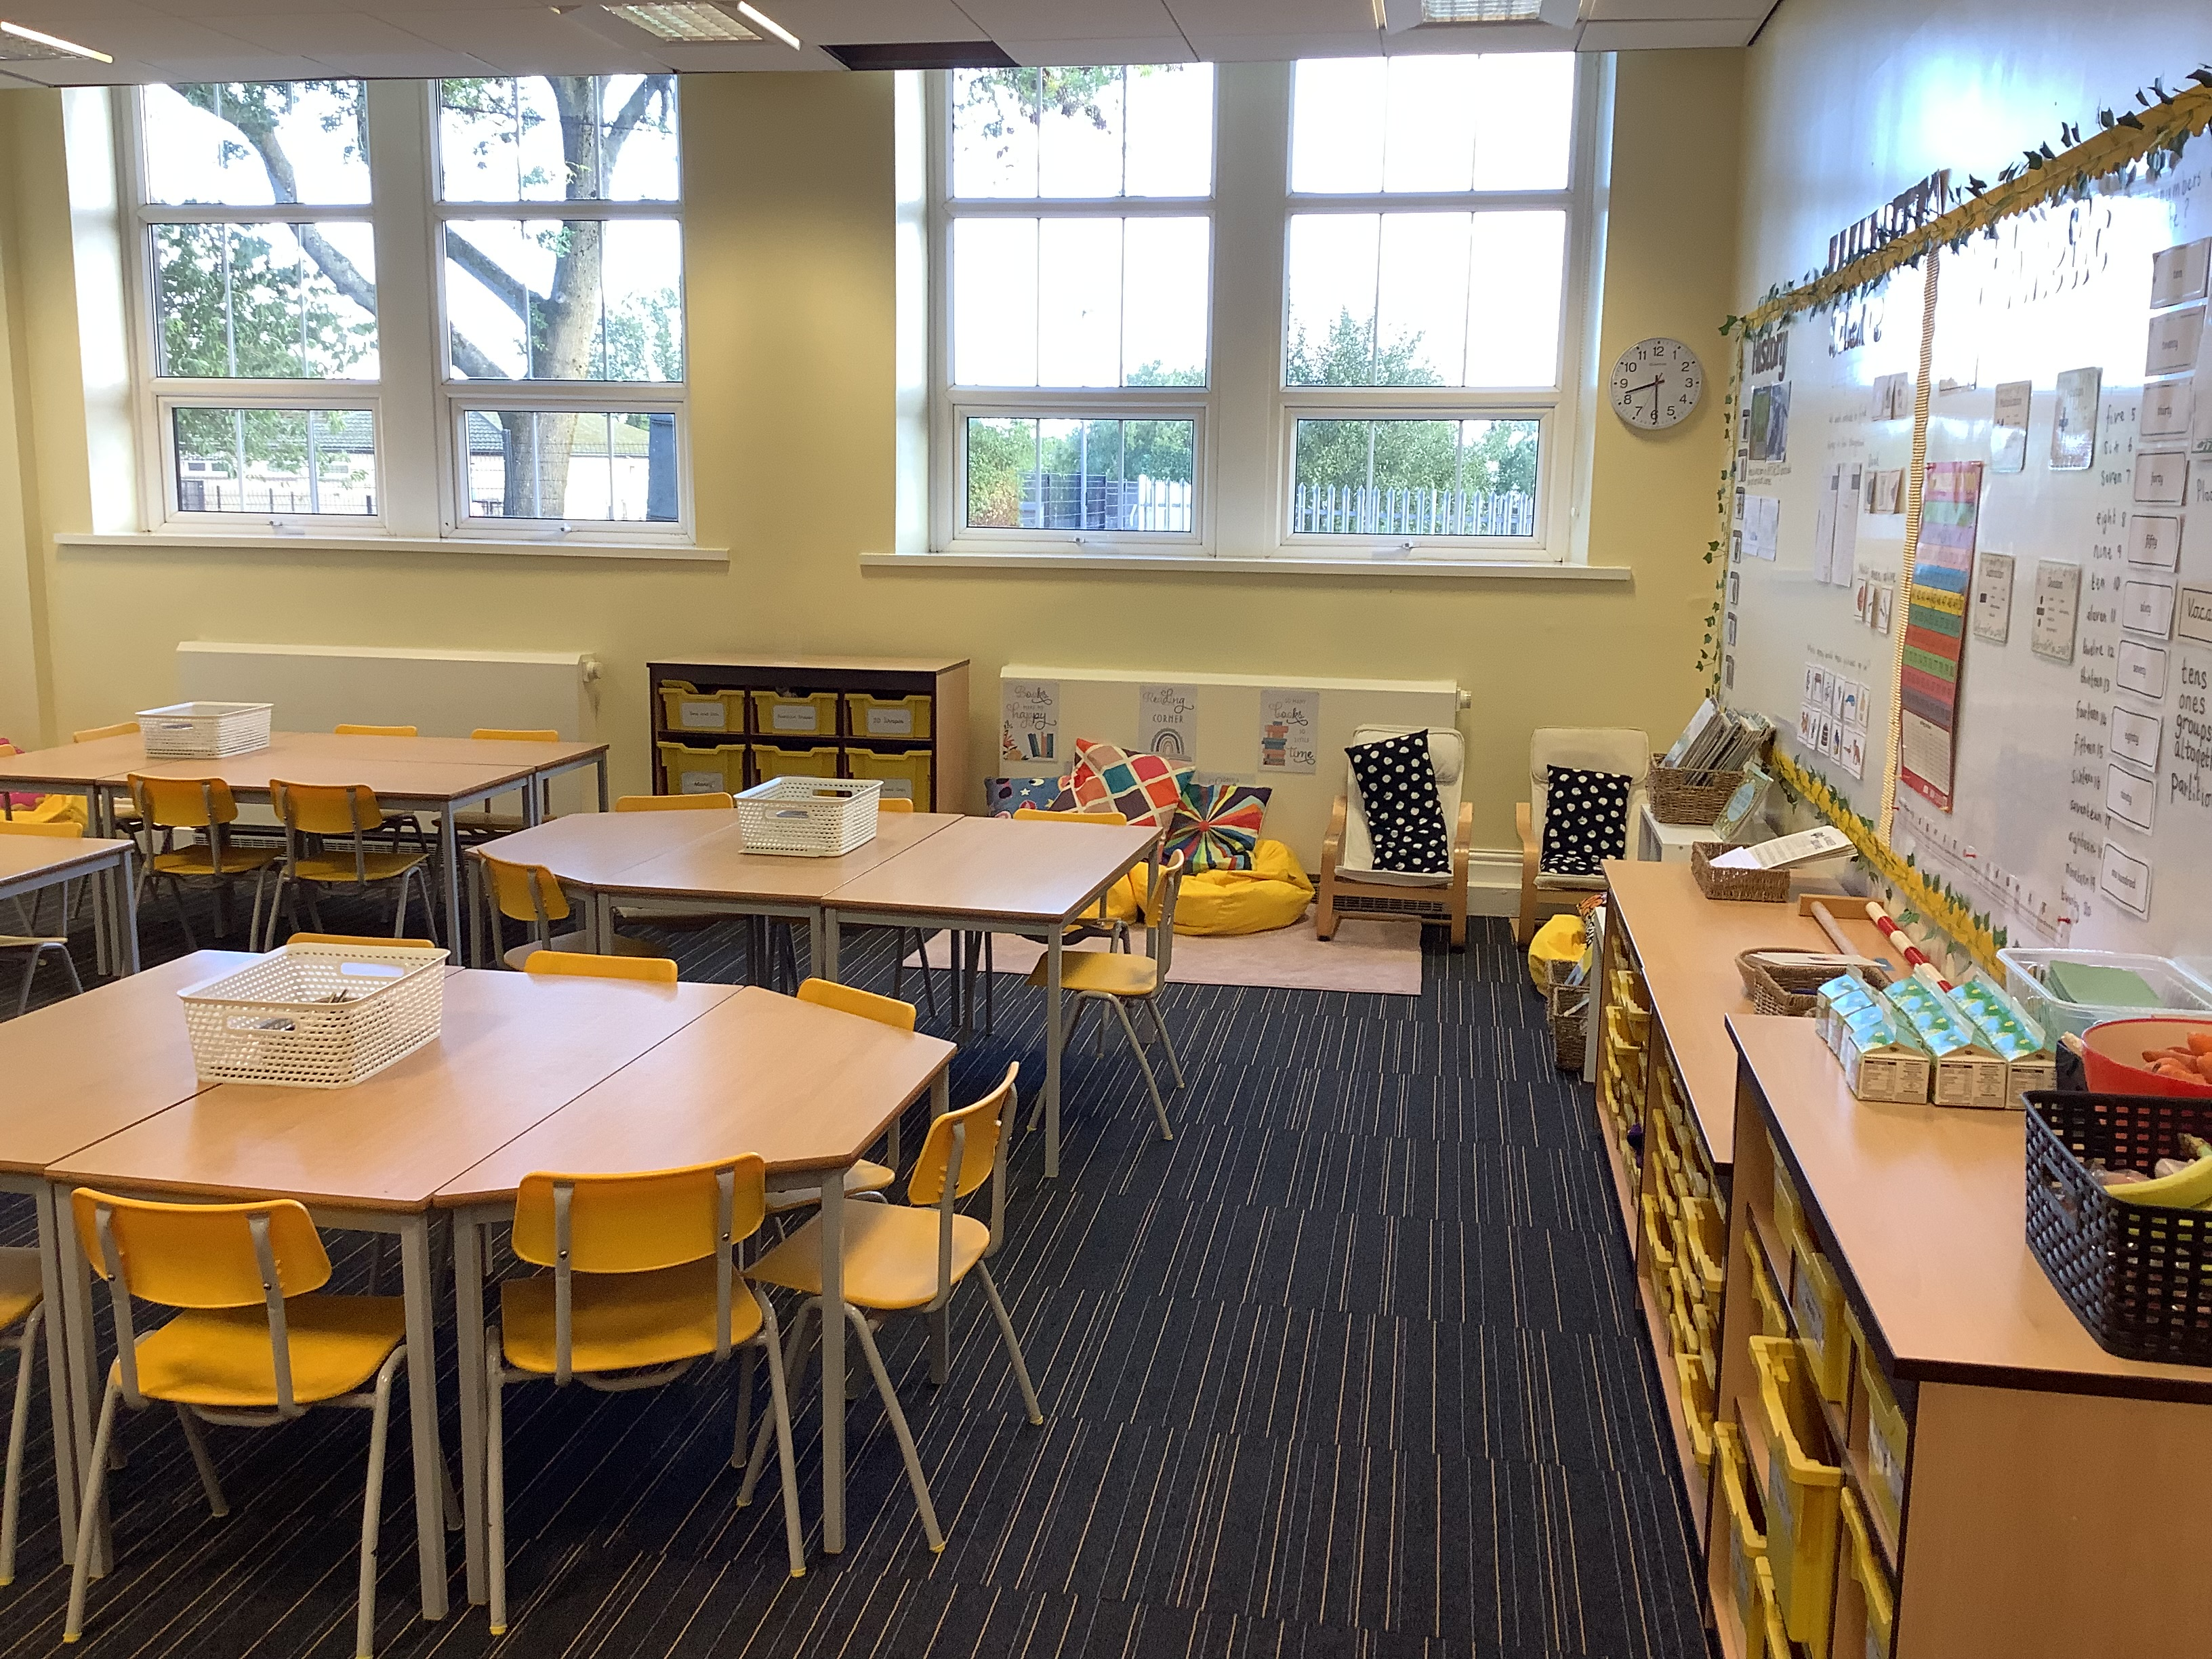
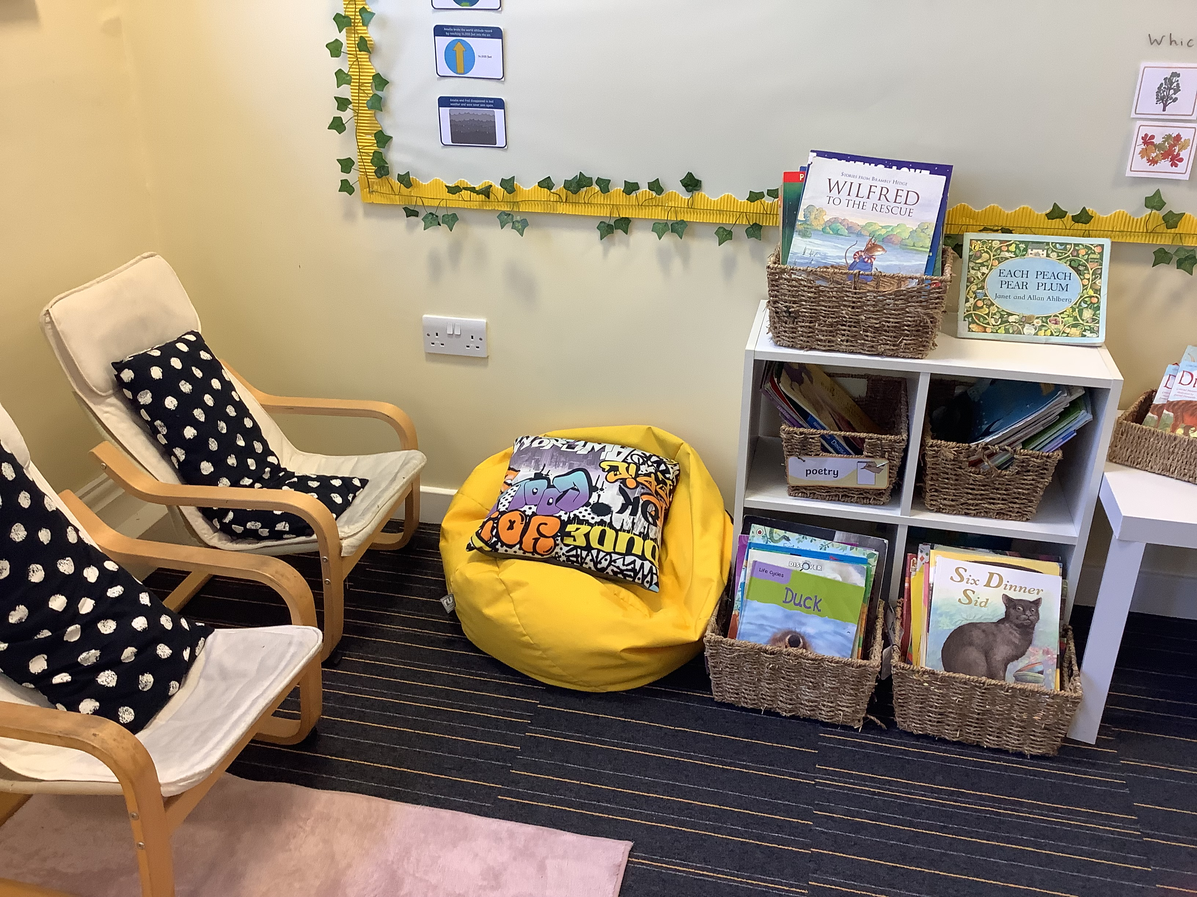
Class 2.1

Slide 12
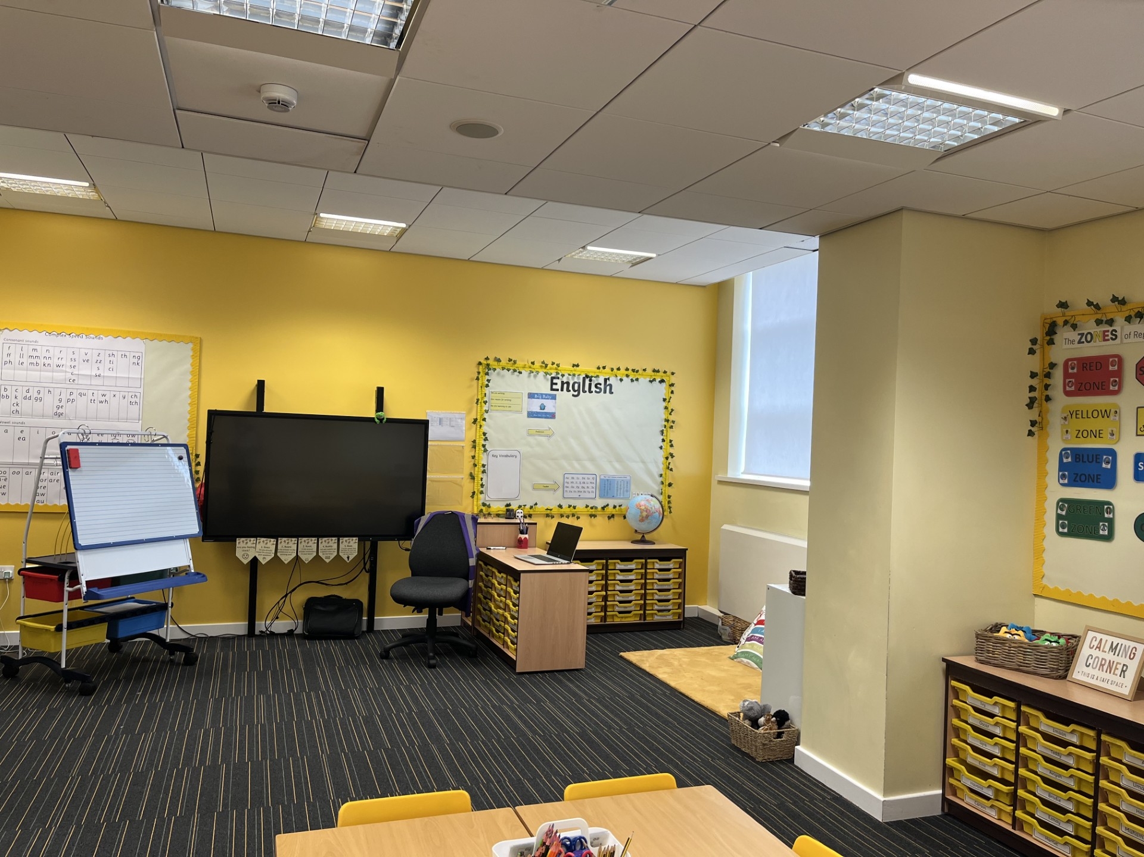
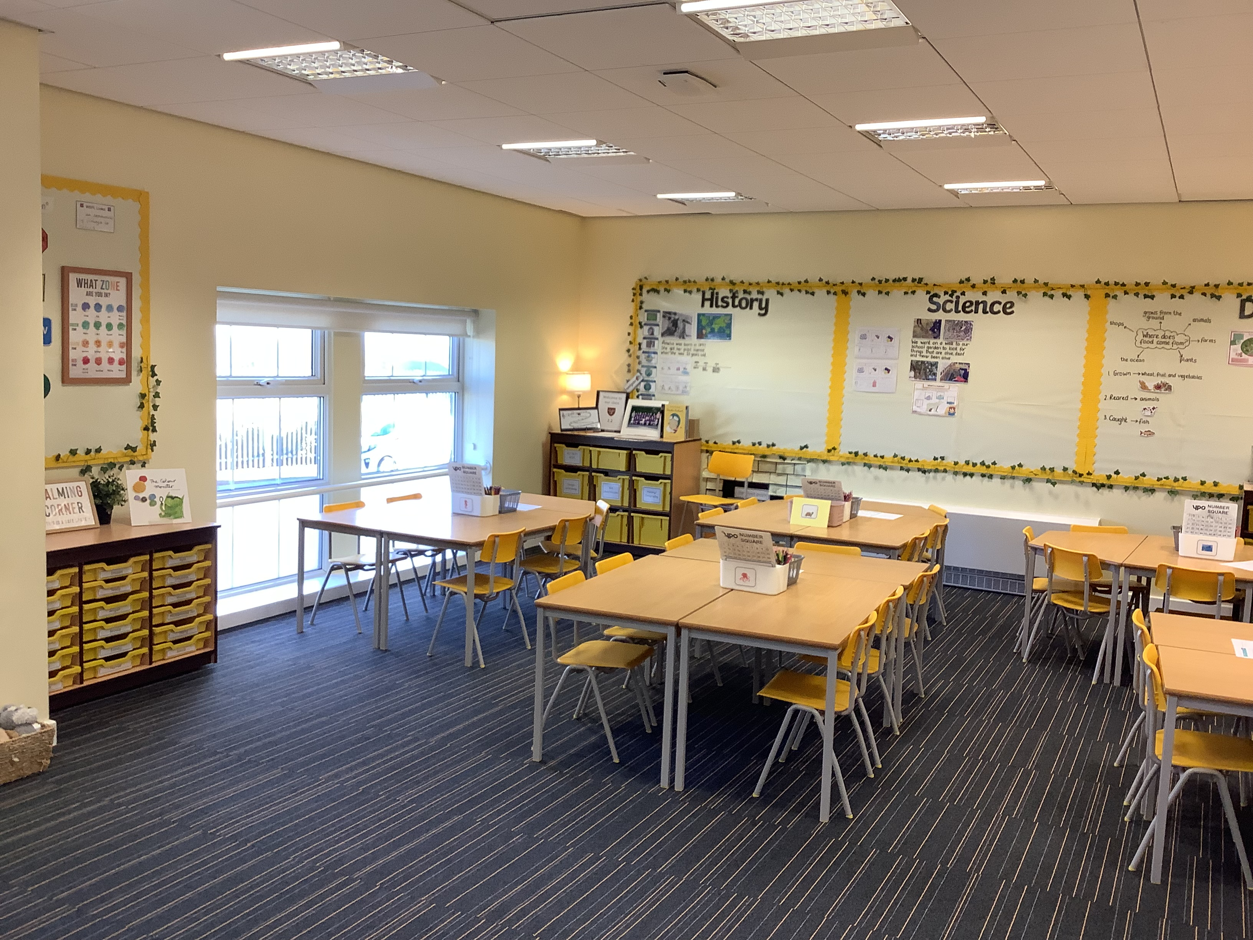
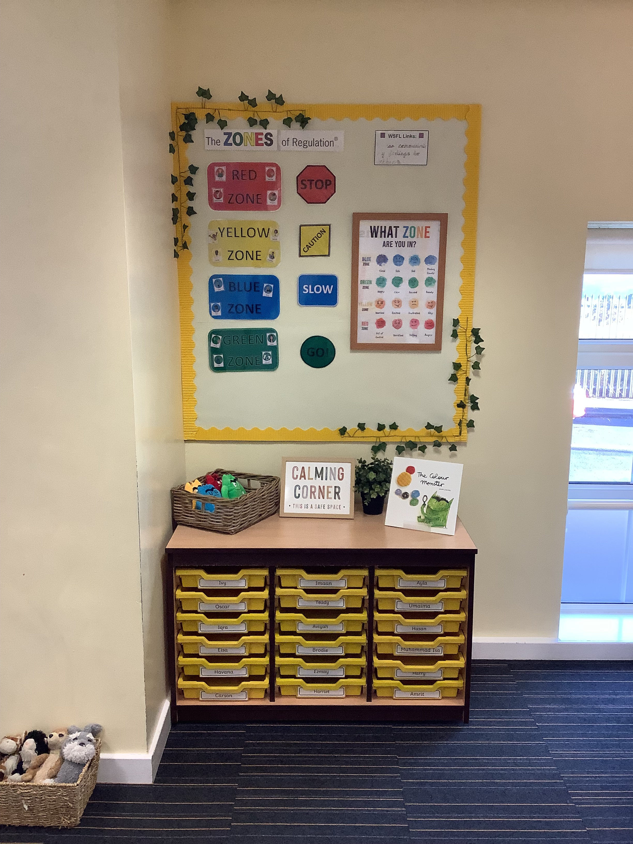
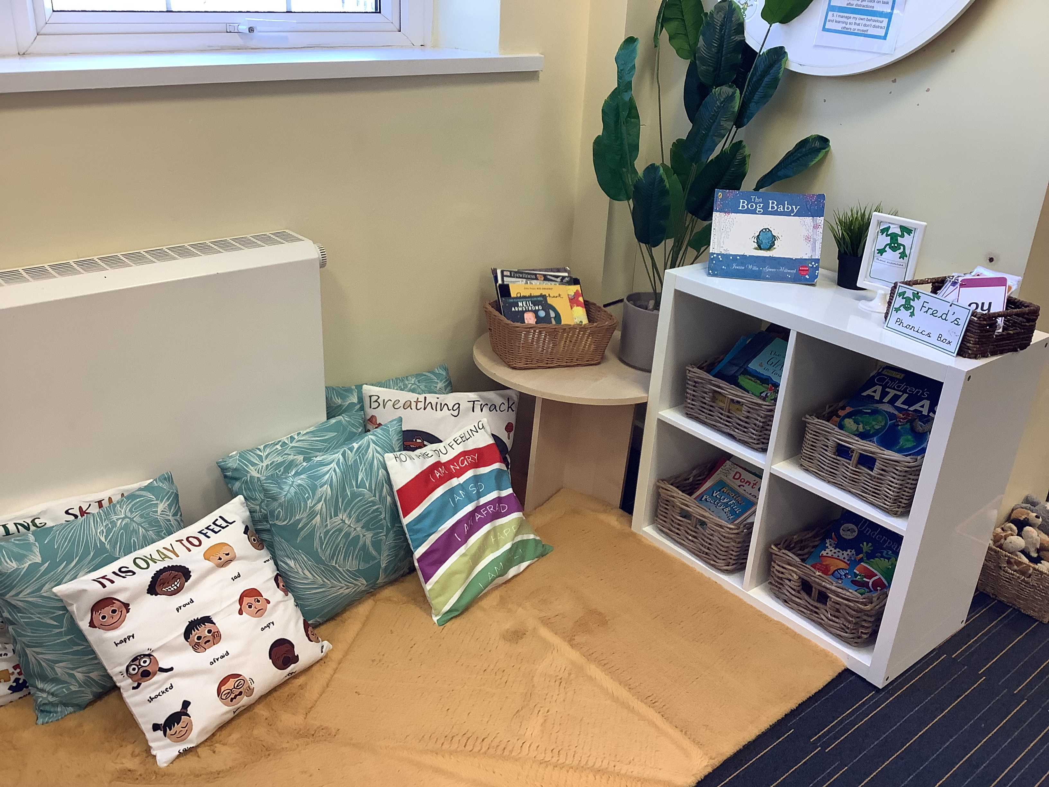
Class 2.2

Slide 13
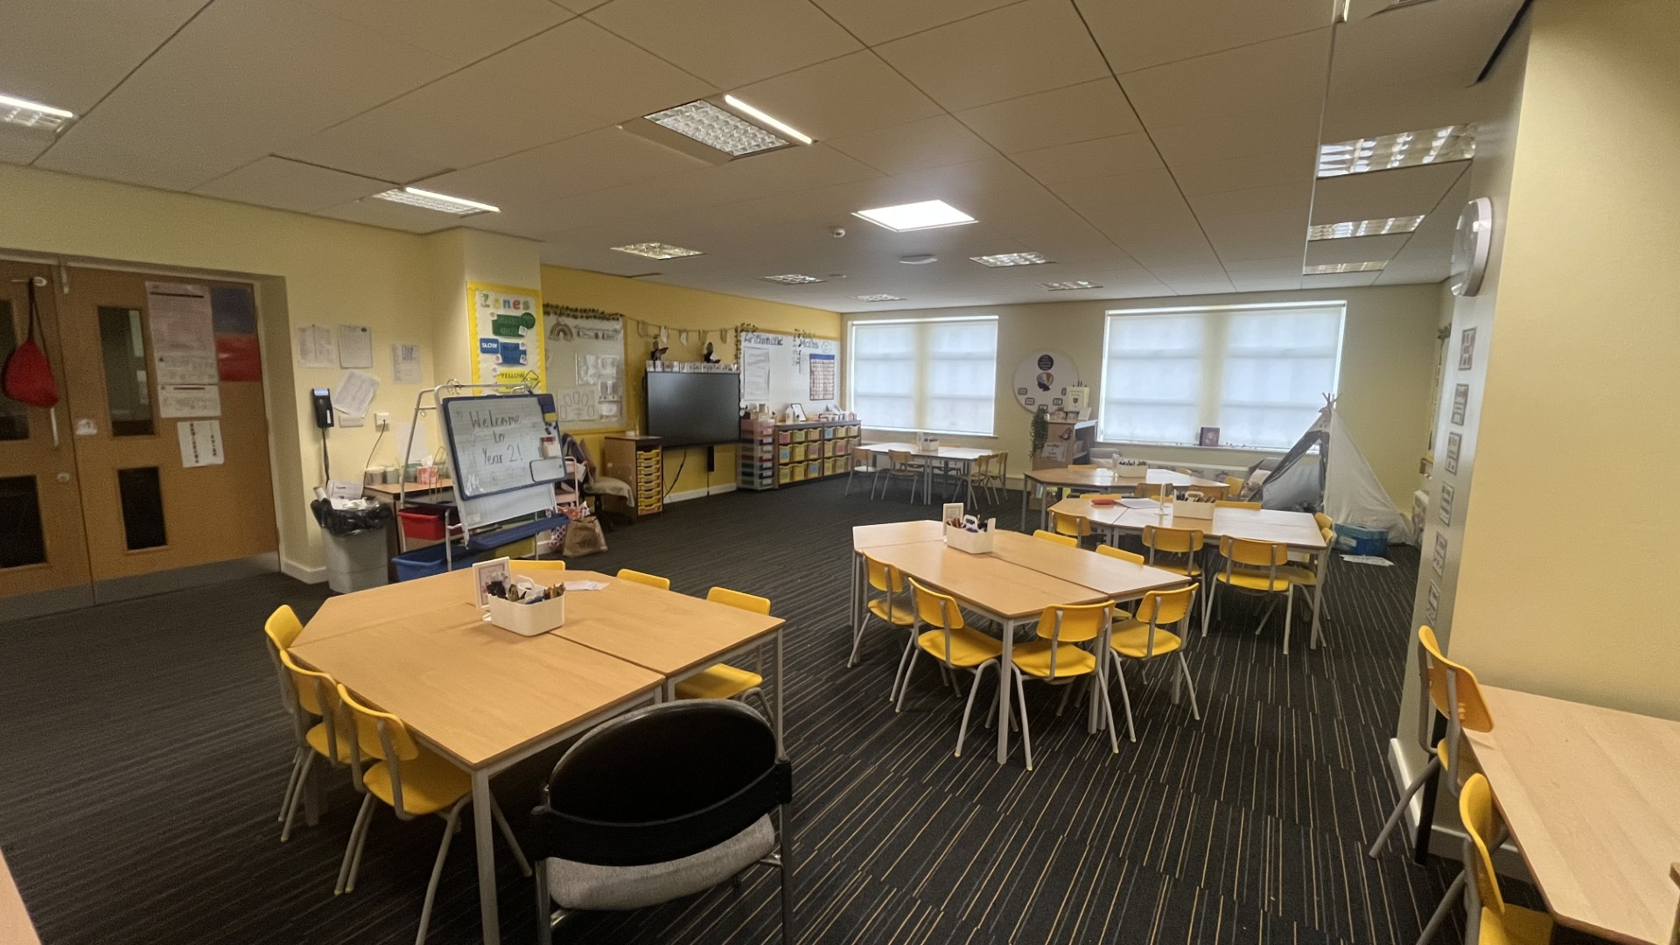
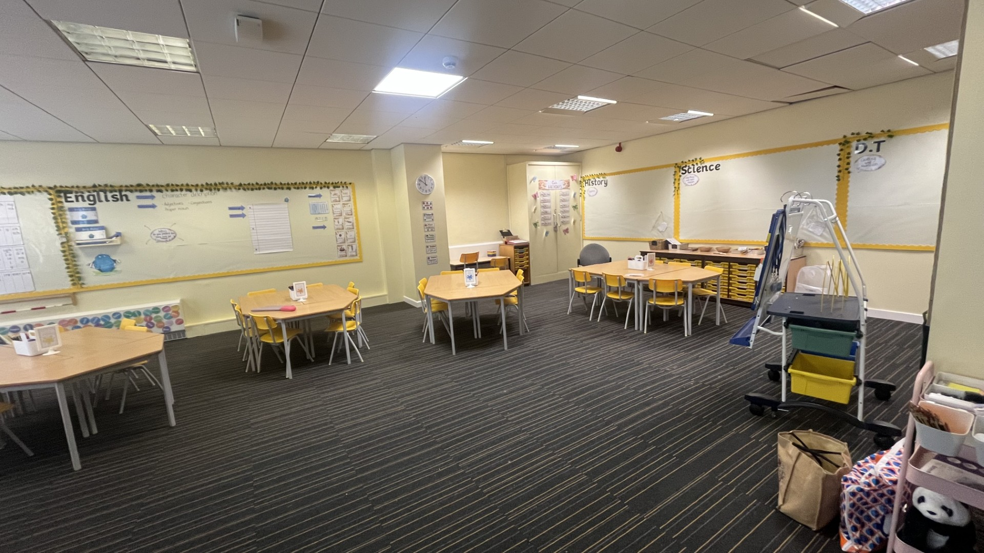
Class 2.3

